Slide 1

Multi-Factor Portfolio Optimization for Indonesian Banking Stocks
This presentation outlines a sophisticated portfolio optimization model designed for Indonesian banking stocks, leveraging a utility maximization framework that integrates multiple risk factors and accounts for transaction costs.

Slide 2
Key Assets Under Analysis
Our model focuses on four prominent Indonesian banking institutions, pivotal players in the nation's financial landscape.
BBCA
BBRI
BMRI
BBNI
Bank Central Asia
Bank Rakyat Indonesia
Bank Mandiri
Bank Negara Indonesia

Slide 3

Data Foundation & Statistical Insights
Data Collection
Computed Statistical Measures
Period: January 1, 2022 – October 31, 2025
Expected Returns (μ): Mean daily returns for each asset, foundational for forecasting.
Source: Yahoo Finance (yfinance library)
Returns: Log returns from adjusted closing prices
Covariance Matrix (Σ): Essential for understanding asset interdependencies and portfolio volatility.
Skewness (s): Quantifies the asymmetry of return distributions, highlighting potential for extreme gains or losses.
Kurtosis (k): Measures the "tailedness" of return distributions, indicating proneness to extreme events (tail risk).

Slide 4
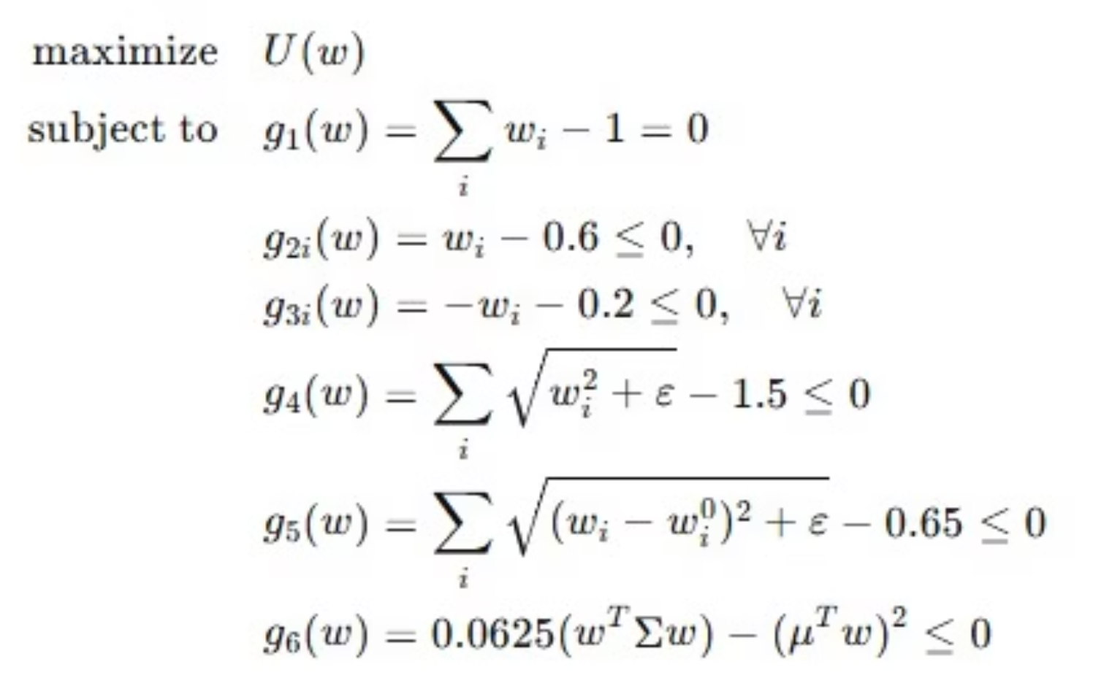
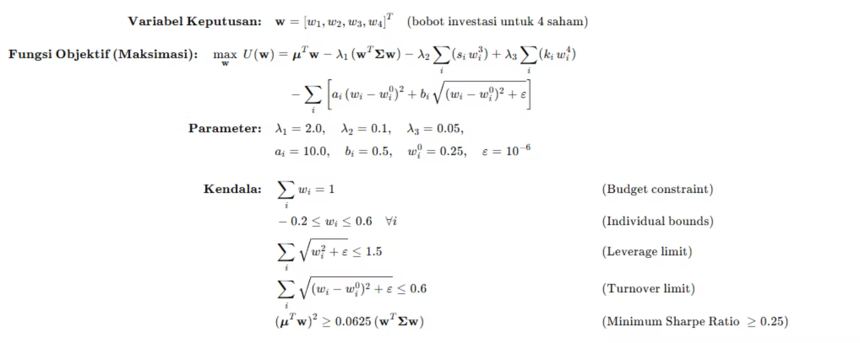
Utility Maximization Objective Function

Slide 5

Rigorous Constraints for Realistic Portfolios
To ensure practical and robust portfolio construction, the optimization adheres to a comprehensive set of constraints.
01
02
Budget Constraint
Leverage Constraint
The sum of all asset weights must equal 1, representing a fully invested portfolio.
Total portfolio exposure is capped at 1.5, allowing for moderate leverage.
03
04
Turnover Constraint
Box Constraints
Portfolio rebalancing is limited to 0.6, controlling excessive trading activity.
Individual asset weights are bounded between -0.2 and 0.6, permitting limited short selling while preventing overly concentrated positions.

Slide 6


Optimization Methodology: SLSQP and Multi-Start Approach
We employ a robust optimization strategy to ensure the discovery of globally optimal solutions, mitigating the risk of local optima.
Optimization Method: Sequential Least Squares Programming (SLSQP)
Multi-start Approach: Five distinct runs are executed with varying initializations to thoroughly explore the solution space.
Initial Parameters:
Starting Weights: Equal allocation of 0.25 for each asset.
Transaction Cost Parameters: a = 10.0, b = 0.5.
Smoothing Parameter: ε = 1×10⁻⁶.
The purpose of the multi-start strategy is to effectively test for local versus global optimum detection, increasing confidence in the final portfolio allocation.

Slide 7

Numerical Results: Optimal Weights and Performance Metrics
The optimization process yields a clear set of optimal portfolio weights and a detailed breakdown of performance metrics.
Key Outputs
Portfolio Metrics
Optimal portfolio weights for each asset
Expected return (daily and annualized)
Weight changes from initial allocation
Standard deviation (daily and annualized)
Maximum utility value achieved
Sharpe ratio
Turnover

Slide 8




Global Optimum Assessment
To ensure the robustness of our solution, we meticulously assess the outcomes from multiple optimization runs.
Utility Comparison
Standard Deviation of Utilities
Best Solution Identification
Compares utility values across all successful optimization runs to identify consistency.
Calculates the standard deviation of utilities across runs, serving as an indicator of solution stability.
Identifies the best solution among all multi-start runs, representing the highest achieved utility.

Slide 9
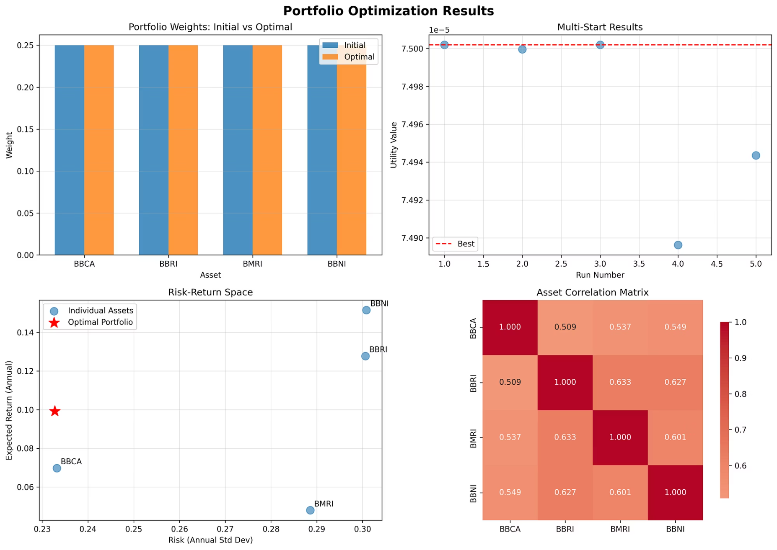
Comprehensive Visualizations
A four-panel visualization provides an intuitive overview of the optimization results, aiding in quick interpretation and analysis.
These charts collectively offer a powerful narrative of the portfolio's rebalancing, performance consistency, risk-reward profile, and inter-asset relationships.

Slide 10
Exportable Results for Further Analysis
The model's outputs are readily available in widely compatible formats for easy integration into other analytical workflows or reporting systems.
PNG Visualization File: A high-quality image of the four-panel chart, complete with a timestamp for clear version control.
Asset
Initial_Weight
Optimal_Weight
Change
Expected_Return
Std_Dev
Skewness
Kurtosis
CSV Results File: A detailed comma-separated values file containing all numerical outputs per asset for granular analysis.
BBCA
0.25
0.249999488
-5.12E-07
0.00027667
0.014690646
0.040207507
2.866508487
BBRI
0.25
0.249991841
-8.16E-06
0.000506732
0.018938573
0.142908465
2.230059525
BMRI
0.25
0.250001573
1.57E-06
0.000190175
0.018179238
-0.012220243
3.004952871
BBNI
0.25
0.250007099
7.10E-06
0.000601341
0.018951711
-0.097512687
3.295113826

